Slide 1
Present-day strain accumulation along the East Anatolian Fault (EAF) by GNSS Observation
GEOL 7900 mini-project
Dewan Mohammad Enamul Haque
Ph.D. Student, LSU G&G

Slide 2
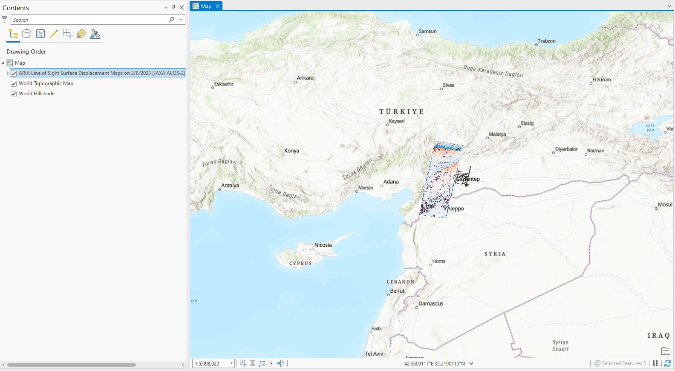
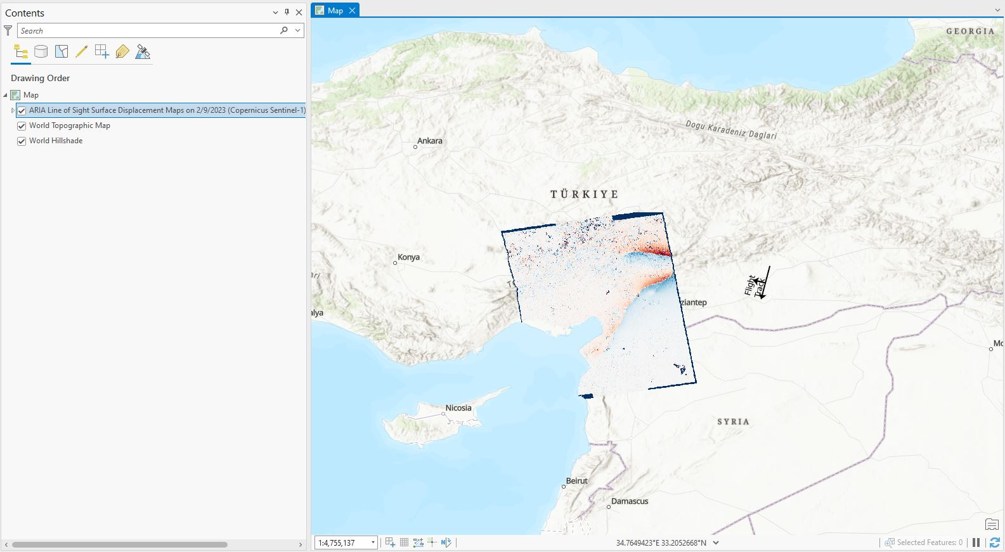

Coseismic displacement field (M7.8)
NAF
NAF
EAF
EAF
On Feb. 6, 2023 a sequence of large earthquakes caused tragic loss of life and massive devastation in Turkey and Syria.
The two largest events M 7.8 and M 7.5 moved the ground by meters near the epicenters.
Source: NASA Products for Turkey Earthquake

Slide 3
Study Area
Nine GNSS stations in and around M7.8 surface rupture
A 24-hour final solution of IGS14 tenv3 GNSS observations
Temporal window (2008-2020)
Data source: Nevada Geodetic Laboratory

Slide 4
3 stations-based GNSS observation
Principal compression is -23.4097 nano strain/year

Slide 5
3 stations-based GNSS observation
Principal compression is -68.5859 nano strain/year

Slide 6
Clean station data (example: GURU)

Slide 7
3 stations-based GNSS observation
Principal compression is -236.2453 nano strain/year

Slide 8
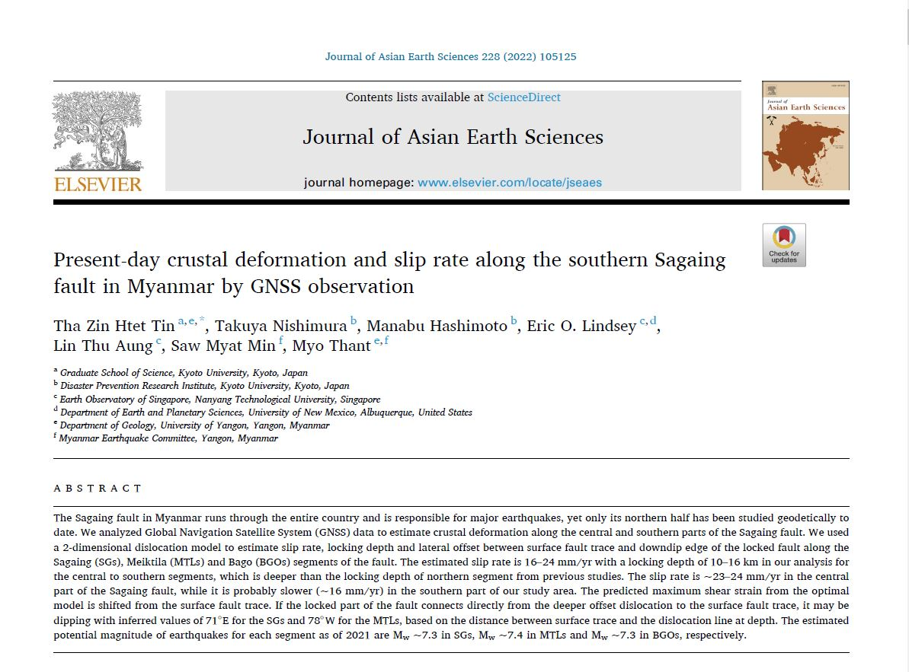

Slide 9
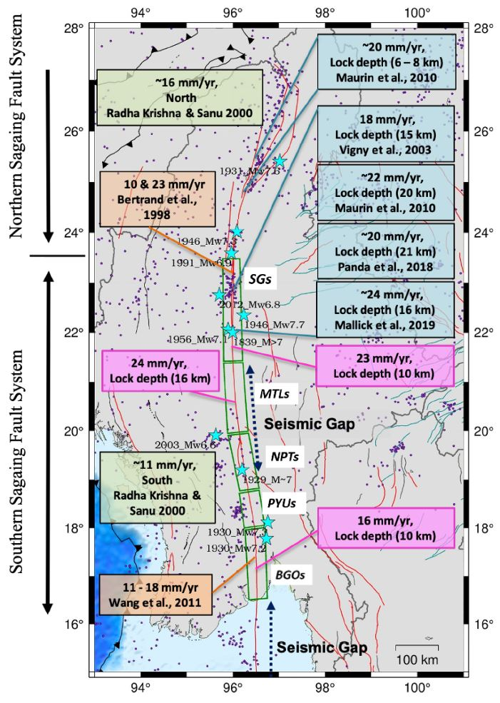
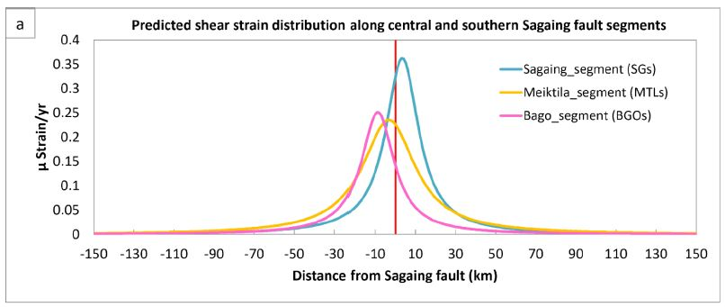
Key findings from Sagaing Fault, Myanmar
In total, the study analyzed data from 18 continuous stations
[8 stations (2016 to 2019 upper and lower transect),
10 stations (2018 to 2019 middle transect and one station from upper
transect)] and 29 campaign stations [16 stations (2017, 2018, 2019),
13 stations (1998, 2000, 2005, 2016)]

Slide 10
Thanks

